Slide 1
Collaborative Development
Eric Müllenbach - Thales

Slide 2
Our agenda
Friday 4
Friday 11
Saturday 5
Saturday 12
General Introduction, Docker, Kubernetes, Distributed Development
Project Day 1
DevSecOps
Project Day 2

Slide 3
Day 2
DevSecOps

Slide 4


What is Quality?
Efficiency
Functionality
Reliability
Maintainability
Hint
"The totality of features and characteristics of a product or service that bear on its ability to satisfy stated or implied needs"
ISO 9001
Usability
Security
Portability
Compatibility

Slide 5
What do we want to achieve?
Quality Dimension | Test type
Functional Suitability | Unit tests
Performance Efficiency | Load tests
Usability | UX tests
Security | SAST, DAST, Penetration tests
Reliability | Resilience tests
Maintainability | Documentation / Code Quality
Compatibility | System tests
Portability | A/B tests
Hint
Keep in mind that there are different aspects of quality.
Throughout this course we’ll focus on functionality, security and maintainability

Slide 6
Deliverables
A tangible output of human effort provided by a developer to a customer.
Software engineering examples are:
Project plan
User manual
Executable code module
Design document
Code listing

Slide 7
Container
Application
Application Runtime
Container OS
System libraries
Orchestrator
Operating System
Infrastructure

Slide 8
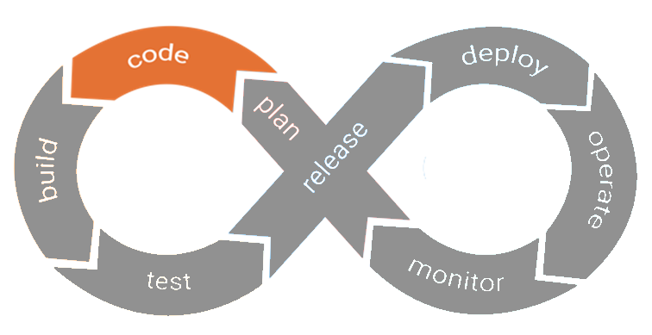
Container
Source Code
Security
3rd party library security
Application
Application Runtime
Container OS
System libraries
Orchestrator
Operating System
Infrastructure

Slide 9



Detect potentially vulnerable source code
Vulnerable code can come in many forms
Attacker can steal your data
Attacker can execute code on your resources
Attacker can shut down your application
Tools you can use:
SonarQube
Microfocus Fortify SCA (former HP)
Notes:
Mention first what problems we are solving, then the tools we are using
Education – Example – Solution
Give concrete example of what are SQL injections and vulnerabilites
Equifax: 100 million people affacted, social security numbers and credit cards

Slide 10
Exercise
https://3r1.co/cd
2.1
Static Code Analysis with Sonar and PMD

Slide 11



Detect vulnerable 3rd party libraries
Your own source code can be vulnerable, but also libraries your project is using
Tools you can use:
OWASP Dependency Check
NexusIQ
Blackduck Hub
Notes:
Mention first what problems we are solving, then the tools we are using
Education – Example – Solution
Give concrete example of what are SQL injections and vulnerabilites

Slide 12
Exercise
https://3r1.co/cd
2.2
Static Code Analysis with OWASP Dependency Check

Slide 13
Clair Vulnerability Scanner
Clair is a popular open source vulnerability scanning solution for docker images made by CoreOS. Clair is also integrated with quay.io public docker registry and Quay Enterprise, both products of CoreOS.
As a source of vulnerabilities, it uses CVE (Common Vulnerabilities and Exposures) data sources like NIST NVD as well as security bug trackers of the specific Linux distributions supported by Clair.

Slide 14
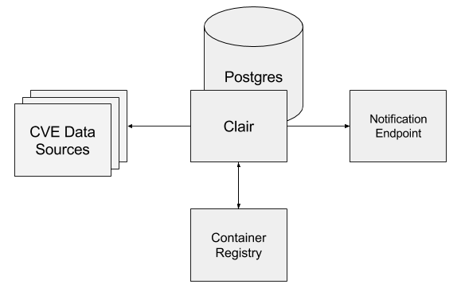
Clair Architecture

Slide 15
Exercise
https://3r1.co/cd
2.3
Docker Security with Clair

Slide 16
Dynamic Application Security Testing
SAST vs. DAST -> Whitebox vs. Blackbox
Attacker does not know about the internals of the application
Can uncover vulnerabilities like
Remote Code Executions
SQL Injections

Slide 17
Exercise
https://3r1.co/cd
2.4
Dynamic Application Security Testing with OWASP ZAP Proxy

Slide 18
Kubernets Security
Pod Security Policies
Limit what a Pod can do
Allow only certain users, limit mount capabilitites
Network Policies
Limit where a Pod can connect to/from
Separation by Namespace or Label Selector

Slide 19
Exercise
https://3r1.co/cd
2.5
2.6
Kubernetes Security

